Slide 1
Some data visualization basics

Slide 2
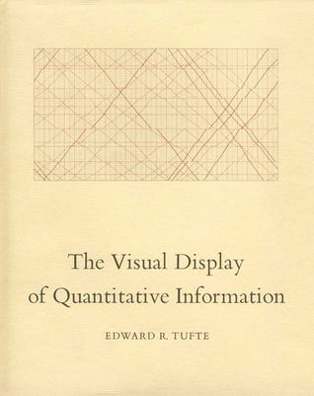
Tufte – The Visual Display of Quantitative Information
Published 1983
He would probably hate this power-point
https://www.norvig.com/Gettysburg/index.htm

Slide 3
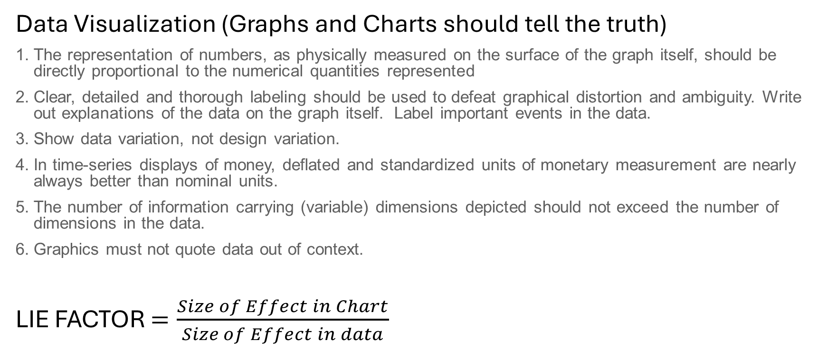
Some Basic Principles
Data Visualization (Graphs and Charts should tell the truth)
The representation of numbers, as physically measured on the surface of the graph itself, should be directly proportional to the numerical quantities represented
Clear, detailed and thorough labeling should be used to defeat graphical distortion and ambiguity. Write out explanations of the data on the graph itself. Label important events in the data.
Show data variation, not design variation.
In time-series displays of money, deflated and standardized units of monetary measurement are nearly always better than nominal units.
The number of information carrying (variable) dimensions depicted should not exceed the number of dimensions in the data.
Graphics must not quote data out of context.
LIE FACTOR $=\frac{Size of Effect in Chart}{Size of Effect in data}$

Slide 4
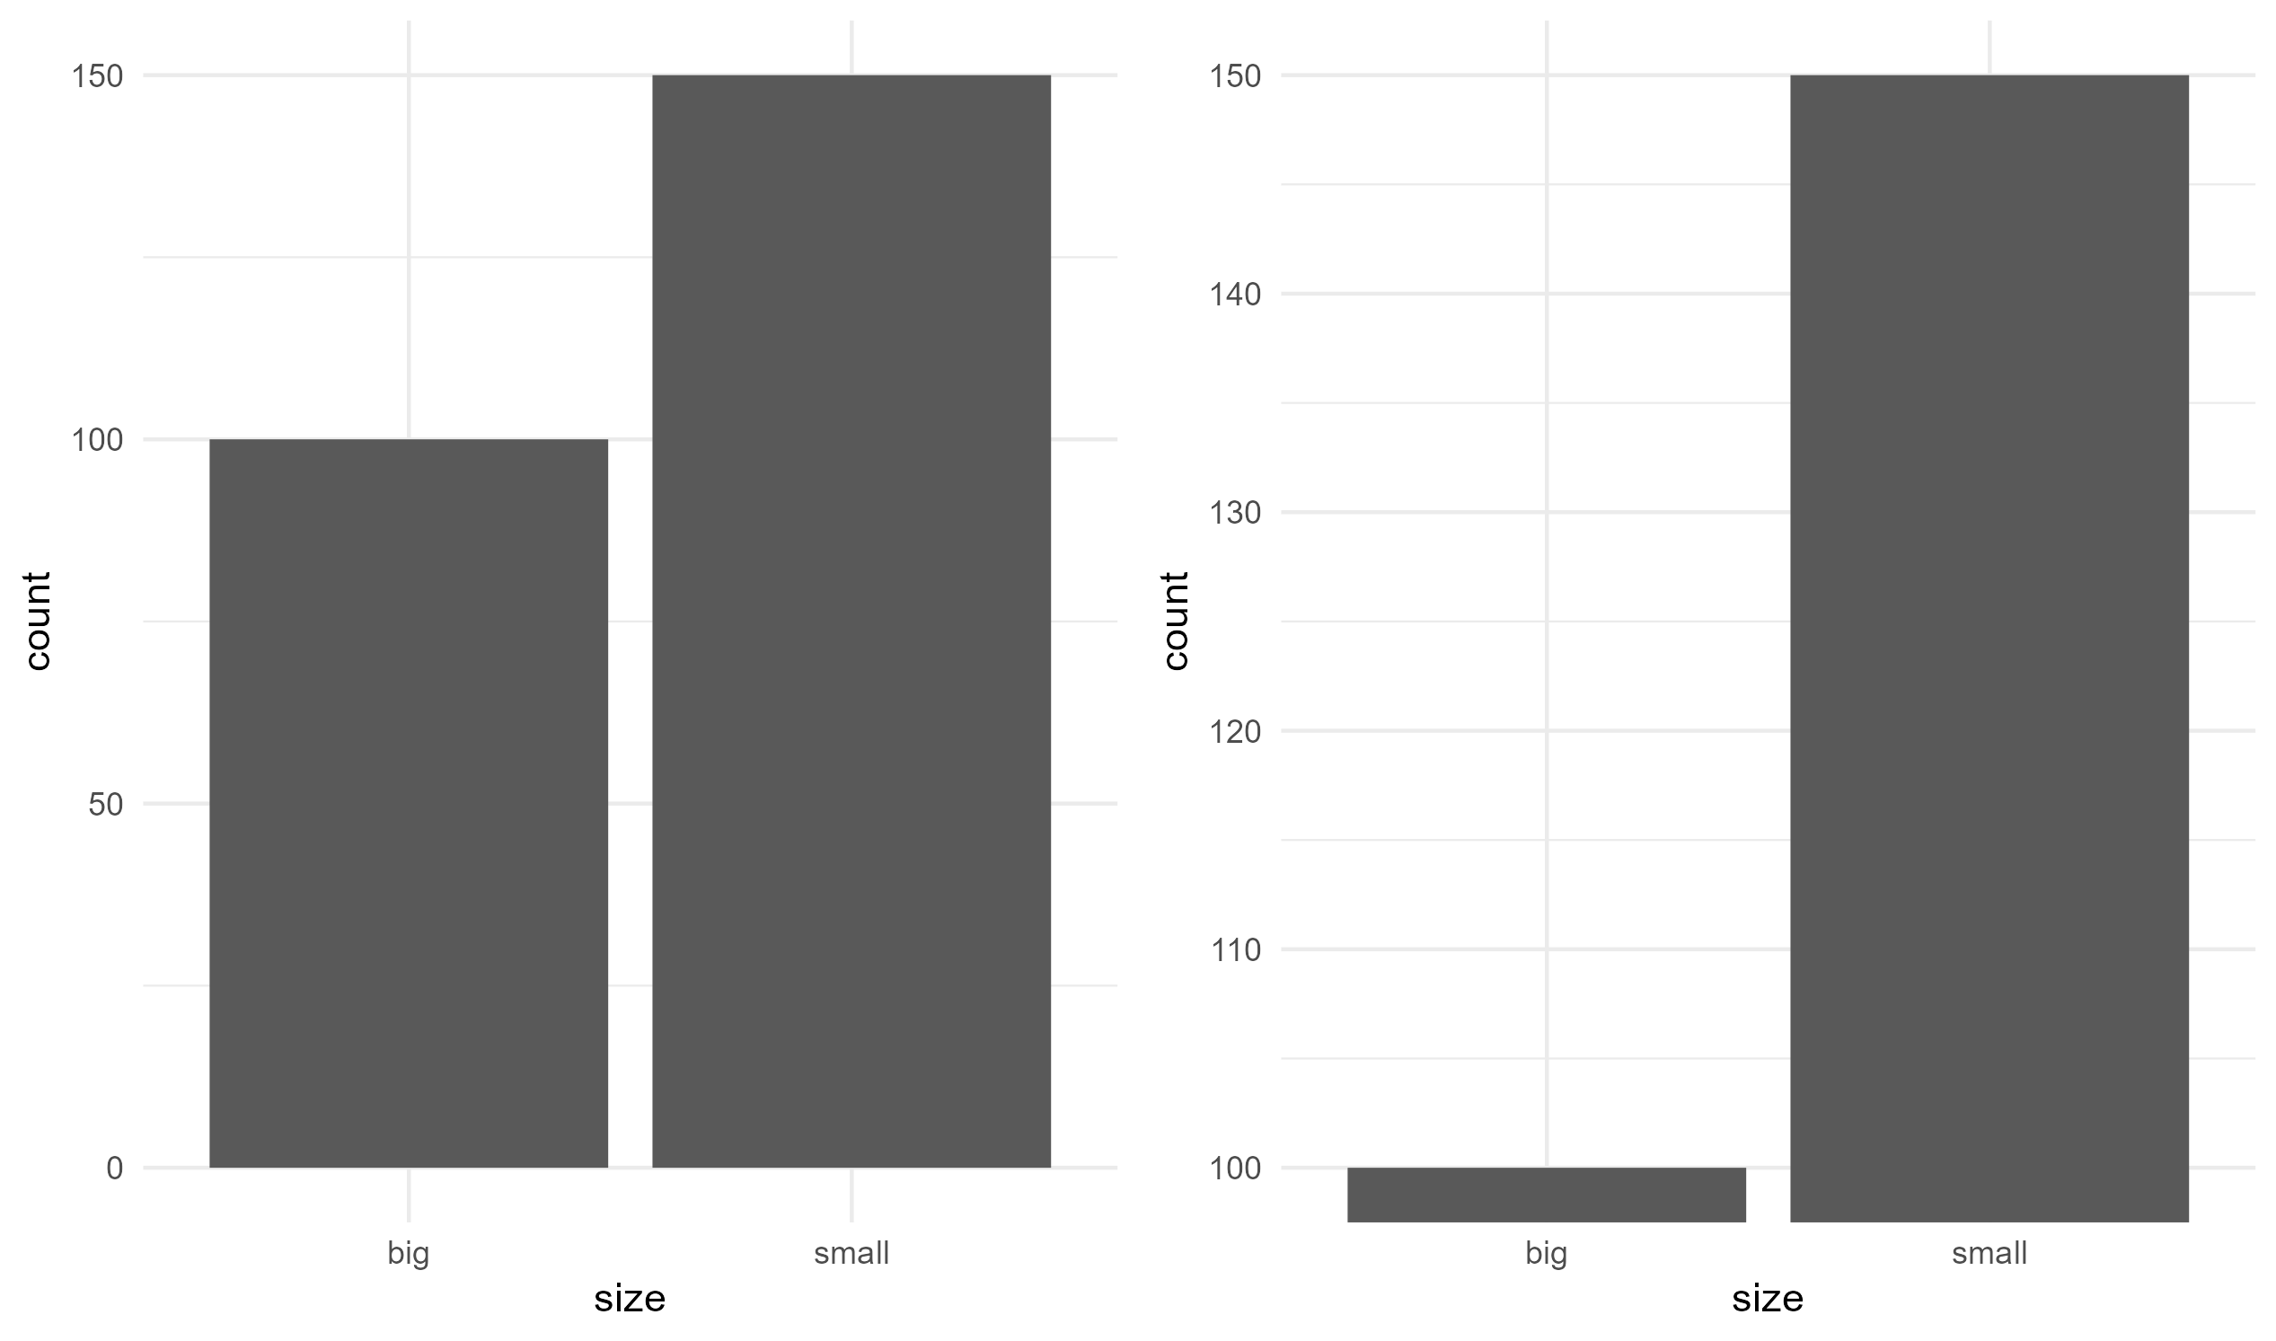

The Lie Factor!
$Lie Factor= \frac{{\left(150−100\right)}/{50}}{{\left(150 −100\right)}/{\left(150 −0\right)}}=\frac{1}{1/3}=3$

Slide 5
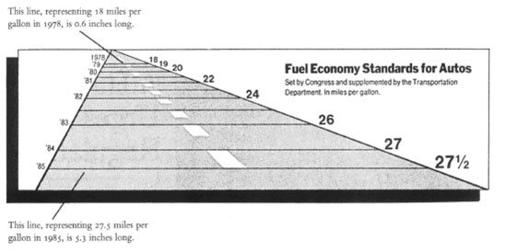
Examples (Lie Factor ~ 15)

Slide 6
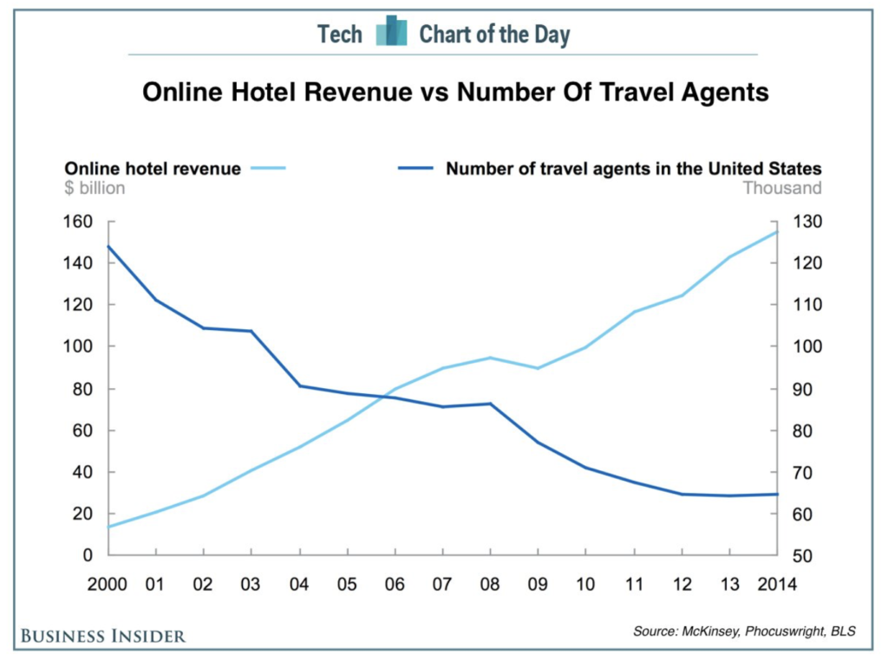
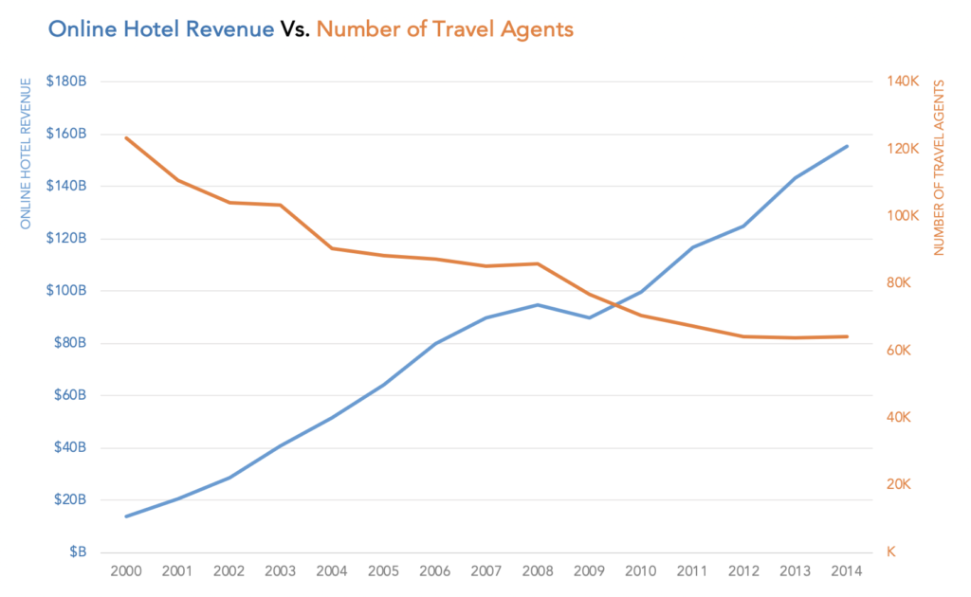
3rd Axis (or 3rd Rail?)
https://daydreamingnumbers.com/blog/dual-axis-charts/

Slide 7
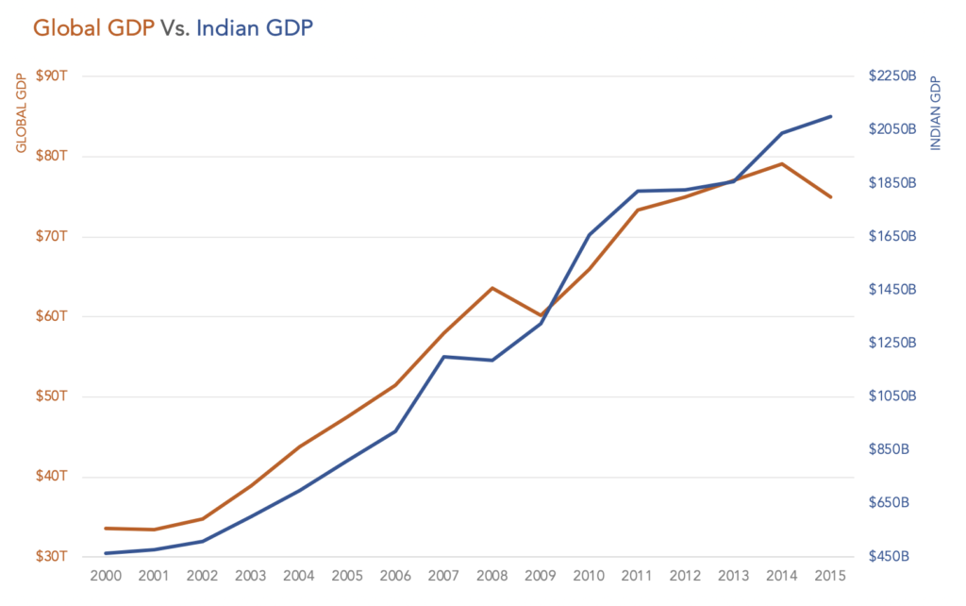
3rd Axis (or 3rd Rail?)

Slide 8
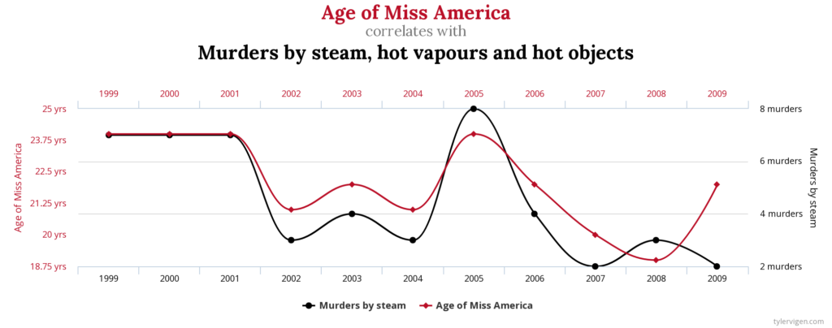
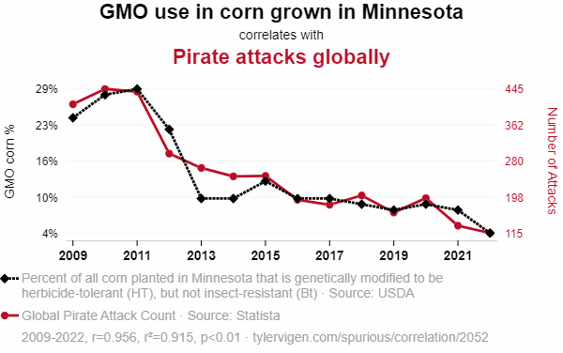
3rd Axis (or 3rd Rail?)
Spurious correlations

Slide 9
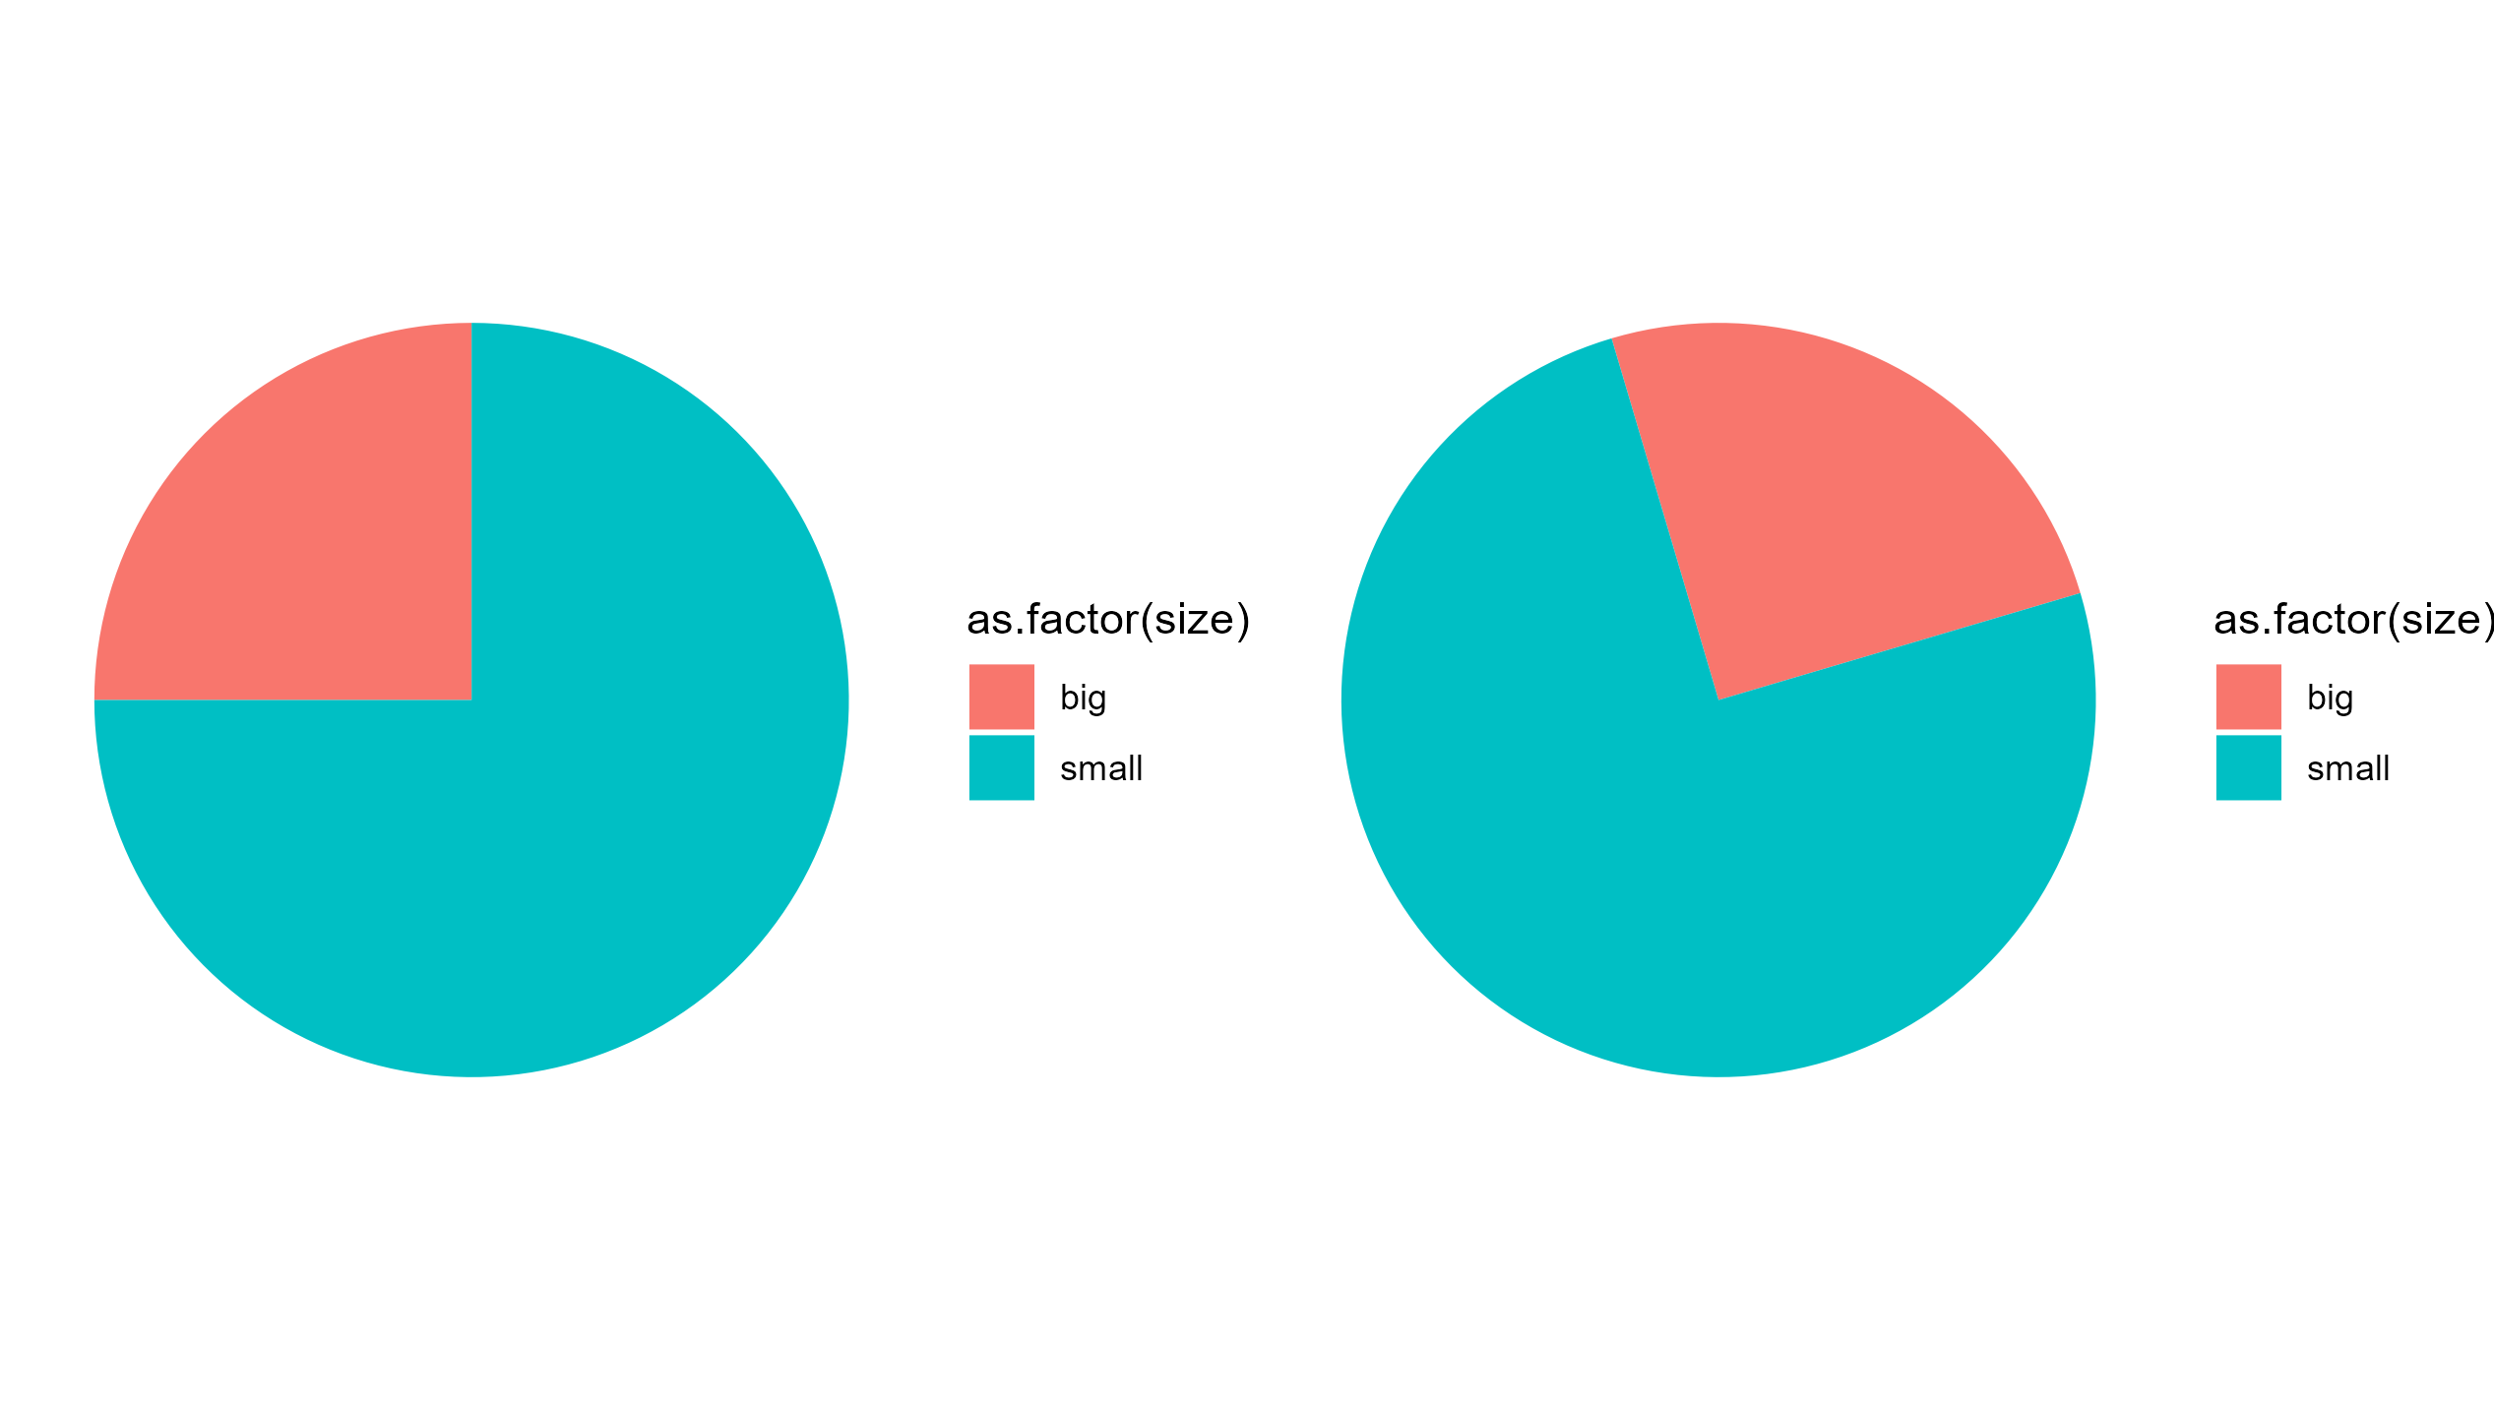
Pie Charts

Slide 10

Data - Ink
$$Data−Ink Ratio= \frac{Data Ink}{Total Ink}$$
Above all else show data.
Maximize the data-ink ratio.
Erase non-data-ink.
Erase redundant data-ink.
Revise and edit

Slide 11
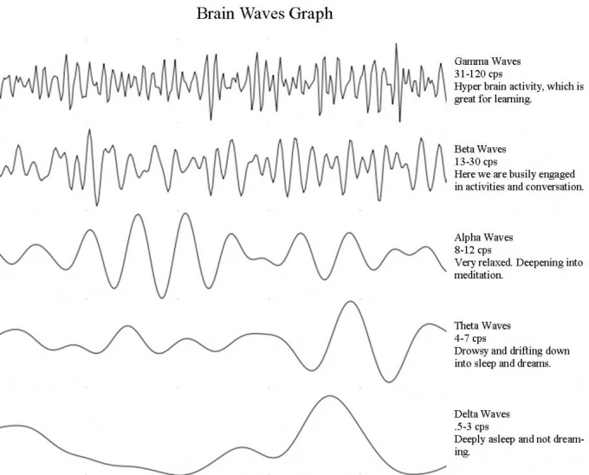
High data-ink ratio

Slide 12
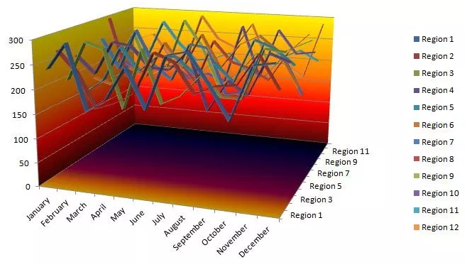
Low data-ink ratio

Slide 13
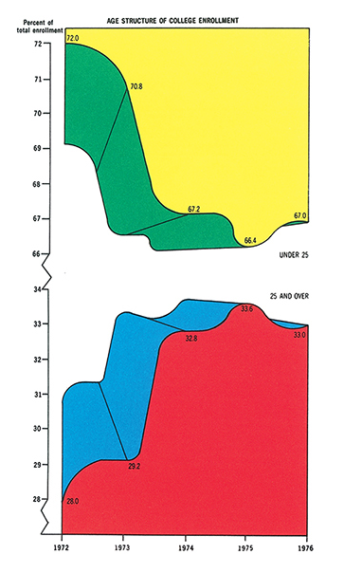
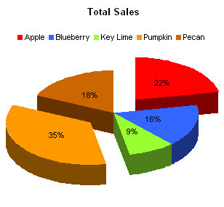
Chart Junk

Slide 14
Design –
https://www.visualmess.com/

Slide 15
Visualization for the Visually Impaired
Often overlooked entirely
Federal Regulations now require all Websites and images produced for websites to be ‘508’ compliant
Section 508 is part of a 1998 amendment to the Rehabilitation Act of 1973.
It requires all Federal electronic content to be accessible.
The U.S. Access Board is an independent Federal agency which develops and maintains standards that must be met to achieve 508 compliance.
The most applicable standards for electronic content are:
– 1194.21 Software applications and operating systems
– 1194.22 Web-based intranet and internet information and applications
– 1194.24 Video and multimedia products

Slide 16
Practically this is likely to apply to
Images
Captions
Color
Data Tables
Dynamic Content/Interactivity
Forms
Navigational Elements/Links

Slide 17
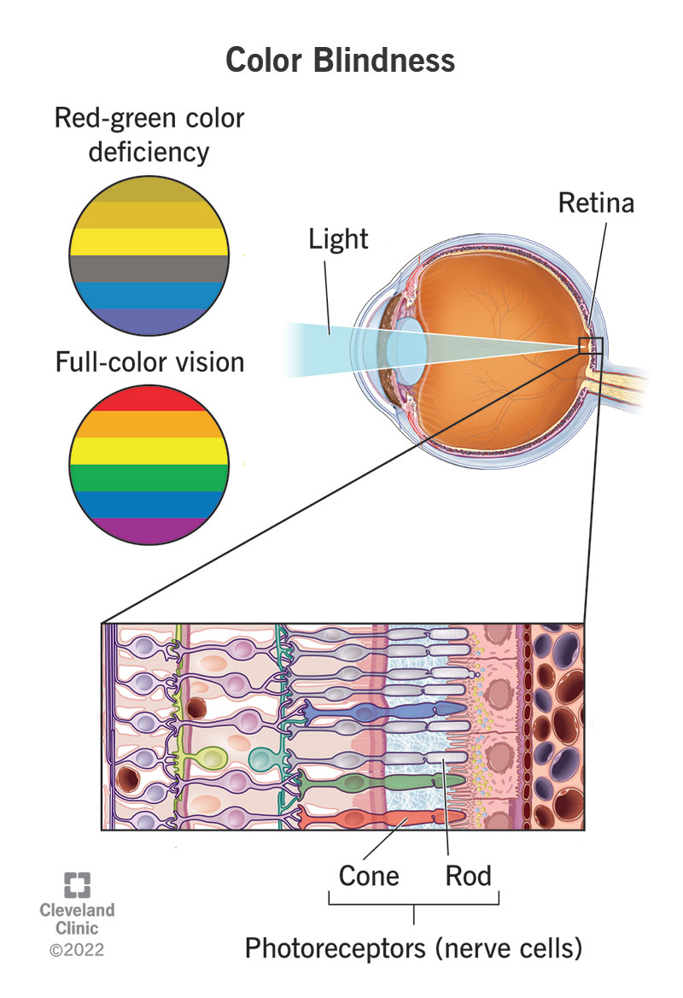
Color
Prevalence of congenital color vision deficiency is ~8% in Men and 0.5% in Women.
Missing one type of cone or lowered/altered sensitivity of one type of cone.
Leads to alterations in perceptions of color and limitations on the ability to differentiate different colors.
As compared to persons with three types functioning with sensitivities at typical levels and to typical wavelengths of light
When there are two types of cone missing altered, perception of color may be nearly absent and intensity may be main differentiating feature

Slide 18
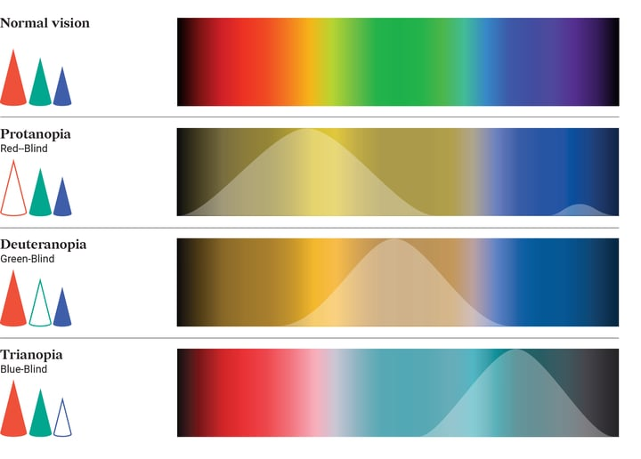
Main types of color vision deficiency

Slide 19
What can you do about this?
Limit use of color as tool to convey information in charts and graphs
Ensure that charts or graphs are interpretable in greyscale as well as in full color.
Choose color combinations which maintain consistent and differentiable interpretations when viewed by people with color vision deficiencies.
Follow good design principles generally (esp. high contrast)
Use Alt-text.

Slide 20
How do you see like someone with color vision deficiency?
Tools exist to help.
Online checkers –
https://www.color-blindness.com/coblis-color-blindness-simulator/
Heuristics – Don’t mix red and green etc…
Online palette generators –
https://venngage.com/tools/accessible-color-palette-generator
Integration into figure/image generation
Dichromat package in R
Viridis package in R

Slide 21
Dichromat – Translation of colors and palettes into deuteranopia / protanopia etc…

Slide 22
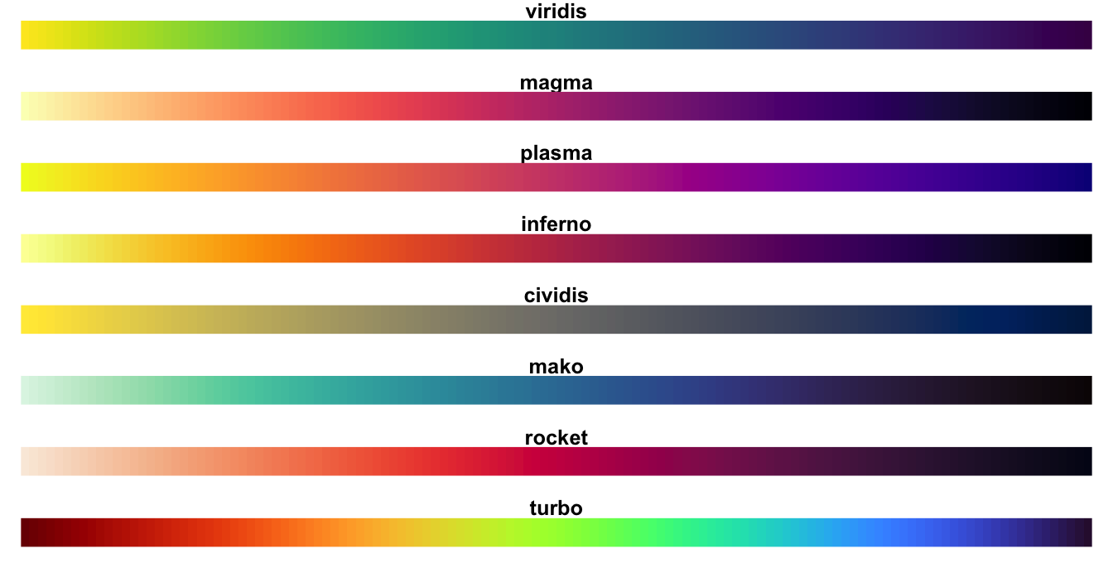
Viridis – palettes which work well for persons with color vision deficiency

Slide 23
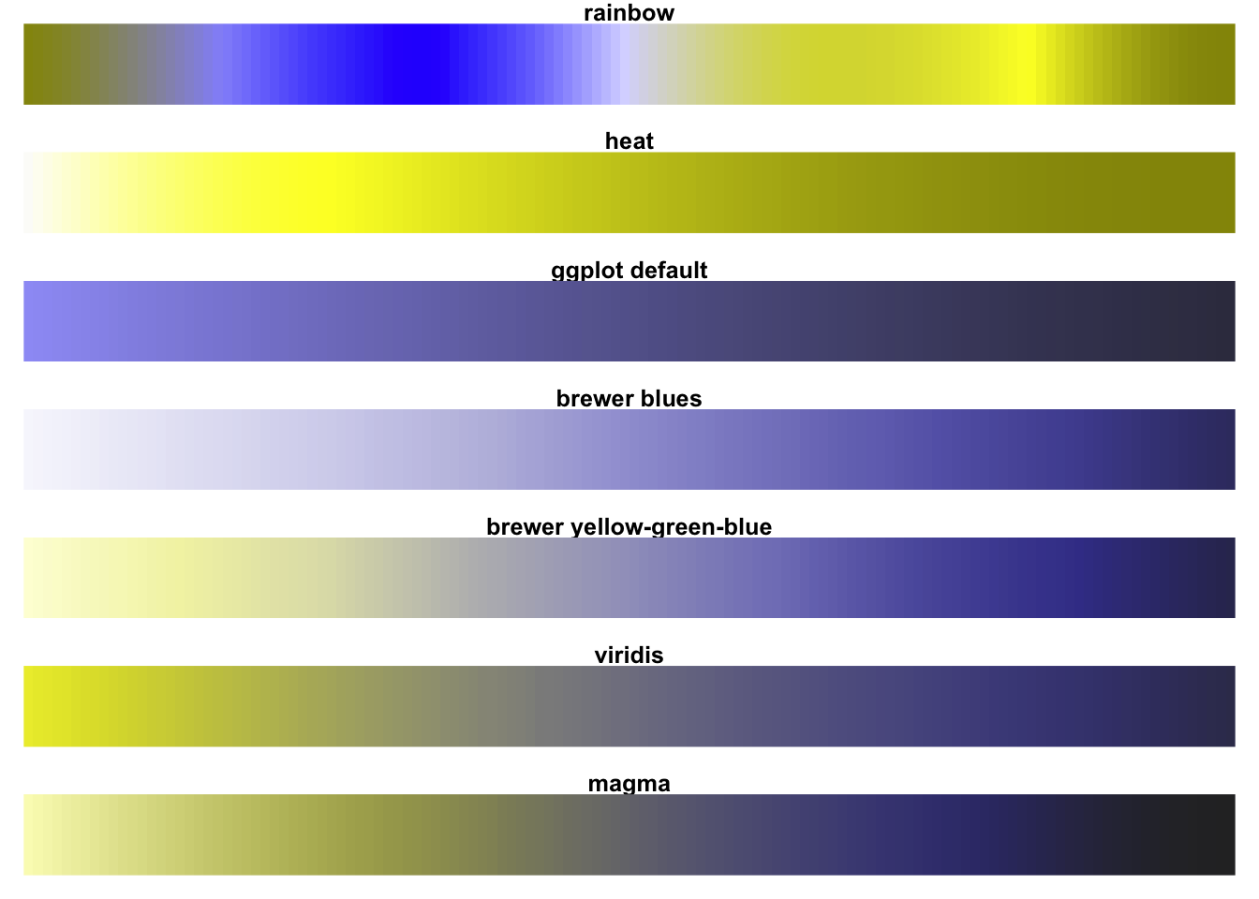
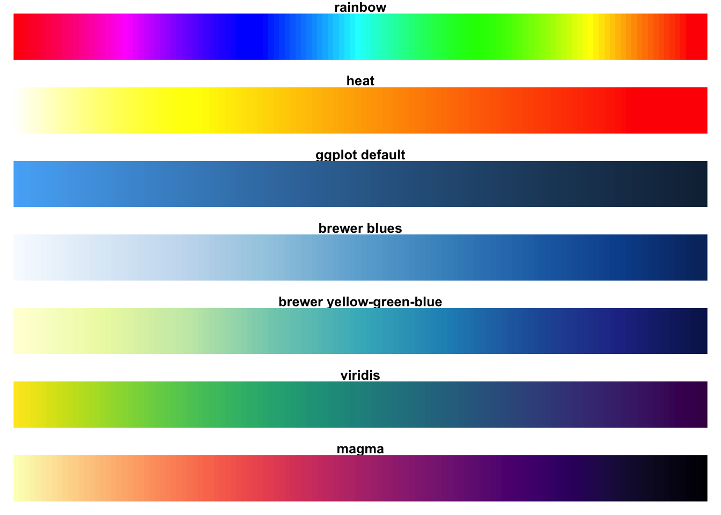
Comparisons to other common palettes in R
Deuteranopia (Green-Blindness)
Typical Vision

Slide 24
https://medium.com/nightingale/writing-alt-text-for-data-visualization-2a218ef43f81

